Slide 1
EENG 385 Pseudo Ramp Generator
Notes:
Usually the <title of the lab> is what will be called the “System” through the rest of this document

Slide 2
Lab Objectives
Analyze, assemble and test a circuit which charges a capacitor through a resistor. Compare the RC charge curve to a straight line to determine if it is sufficiently close.

Slide 3
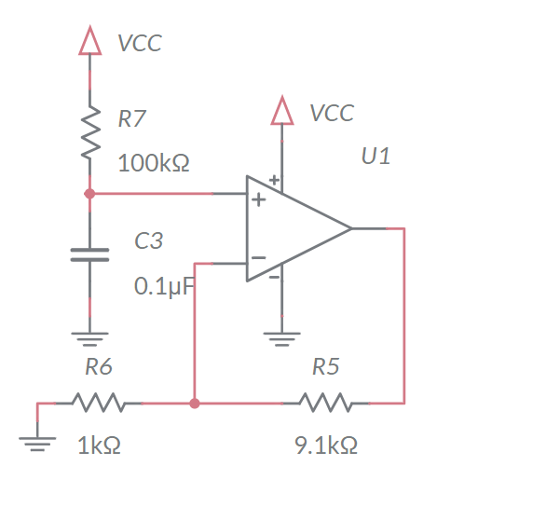
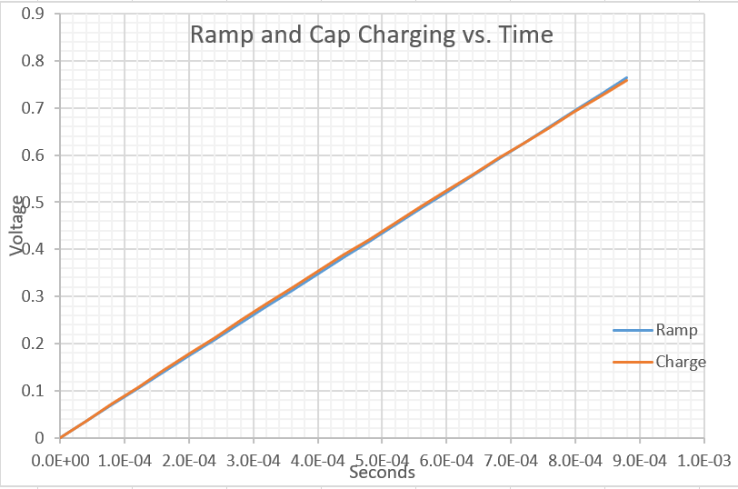
Analyze
The 0.1uF capacitor C3 charges towards VCC = 9V
Charges for 888us then reset by 555 Timer
The charging is close to a straight line
Compare charging cap to a straight line in Excel
Notes:
Replace <System> with the name of the

Slide 4
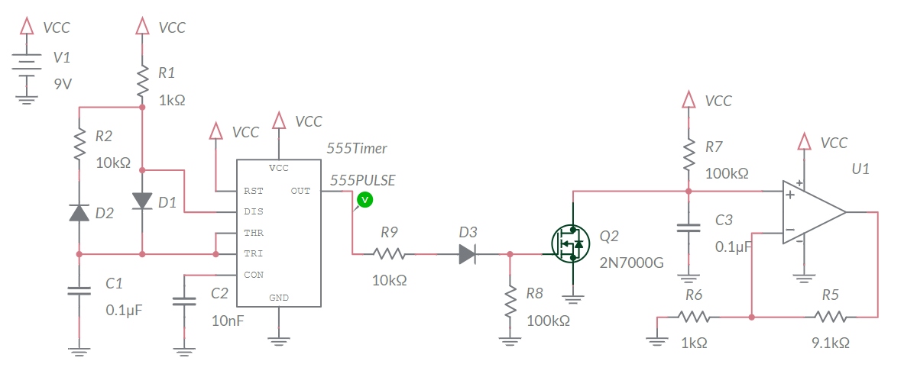
Simulate
Build in Multisim – License M86X55004
Charge on capacitor is cleared by MOSFET
Do not include Schmitt Trigger Oscillator in simulation
Simulate to verify calculations
Notes:
M86X55004

Slide 5
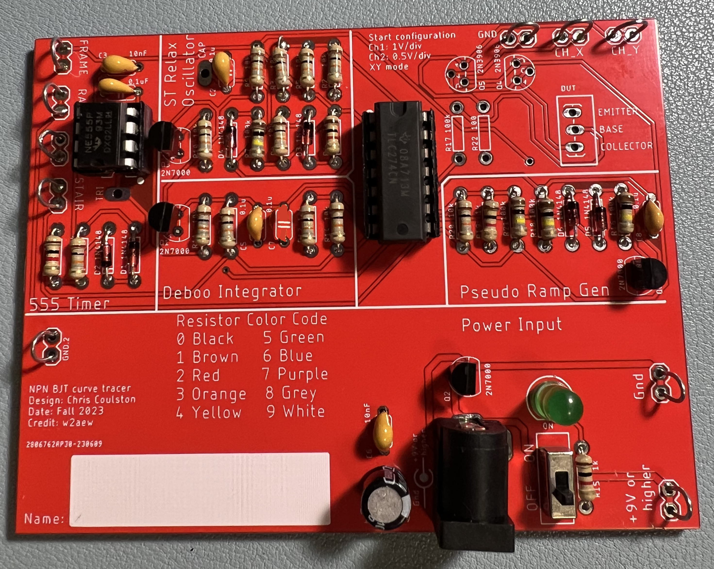
Assemble
Assemble
2N7000 clears charge off cap
Notes:
Replace <System> with the name of the

Slide 6
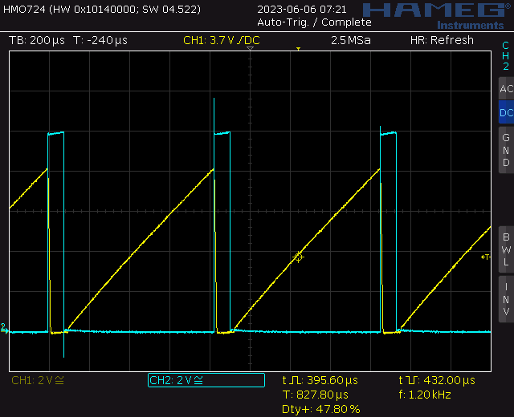
Test
Probe 555TIMER (blue) and RAMP (yellow)
Notes:
Replace <System> with the name of the

Slide 7
Turn In
Summary of analysis, simulation and assemble
Answer listed questions
Save solutions as PDF
Due before start of class next week
Every student builds their own board
Everyone brings their board to class

